Slide 1
The Ethics of Tea Economics Module: Development Economics Lecturer: Dr. Anna Brookes

Slide 2

Production Process
Small Plantations
Large Plantations
Treat & Process
Export

Slide 3

Consumer Considerations
Purchase price – Tea varies in rarity, quality and quantity. Home brand versus organic or premium products.
Packaging design – Is the packaging eco-friendly or recyclable? People like aesthetically pleasing items e.g reusable tin/box.
Brand loyalty – Customers develop an affinity with certain brands due to various influences. Habits lead us to make certain choices when shopping.
Ethical implications – Many shoppers are concerned about funding unethical trade and as such are more likely to be drawn to an organic or Fairtrade product.

Slide 4
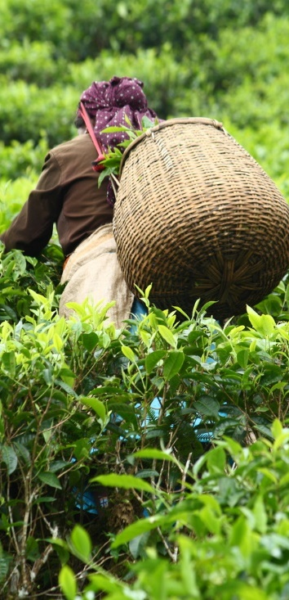
Daily Life
Working Conditions - Long hours of manual labour in the sun.
Wages - Investment and increased overheads can affect labourer wages. Limited skillsets mean that workers struggle to negotiate better pay.
Dependency – Workers depend on employers for health care, education and housing.

Slide 5

Fairtrade Incentives
National minimum wage
Healthcare
Housing
Education

Slide 6

Sri Lankan Plantations with CDFs - Benefits
10-20% increase in volume of tea picked.
16 management hours per week saved.
Reduced strike action saving $2,600-$13,300 per estate per day.
Improved employee perception of well-being.

Slide 7
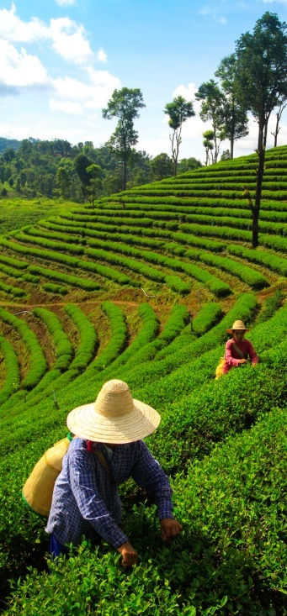
In what ways do organisations such as Fairtrade help or hinder progress for developing economies?
5000 words. Due March 17th 11.59pm

Slide 8
References
http://www.fairtrade.net/tea.html#c3915
http://www.ethicalteapartnership.org/tea-sustainability-programmes/producer-support/fair-treatment-of-workers/
http://www.tea.co.uk/tea-facts
http://in.reuters.com/article/2011/01/14/india-tea-prices-idINSGE70D09U20110114
http://www.history.uk.com/history/history-tea-britain/
http://store.mintel.com/tea-and-other-hot-drinks-uk-july-2014?cookie_test=true

